Slide 1
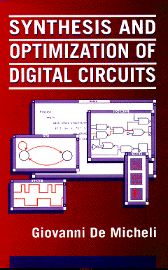
FSM-based Specification Formalisms
Giovanni De Micheli
Integrated Systems Laboratory
This presentation can be used for non-commercial purposes as long as this note and the copyright footers are not removed
© Giovanni De Micheli – All rights reserved

Slide 2
Module 1
Objectives:
Finite-state machines
Synchronous languages
State Charts

Slide 3
Models of computation
Data-flow oriented models
Focus on computation
Data-flow graphs and derivatives
Control-flow oriented models
Focus on control
Based on finite-state machine models
DF and CF model complementary aspects
Notes:
Computational systems can be abstracted by models of computation.
These can be data-flow or control-flow oriented.
They represent complementary aspects.
This lecture deals with control-flow models.

Slide 4
Formal FSM model
A set of primary inputs patterns X
A set of primary outputs patterns Y
A set of states S
A state transition function:
δ: X × S → S
An output function:
λ : X × S → Y for Mealy models
λ : S → Y for Moore models
Notes:
This is the classical model of FSM.

Slide 5
Finite-state machines
Primary Inputs
Primary Outputs
COMBINATIONAL CIRCUIT
REGISTERS
clock
A finite-state machine is an abstraction
Computation takes no time
Outputs are available as soon as inputs are
A finite-state machine implementation is a sequential circuit with a finite cycle-time
Notes:
The FSM model is an abstraction where computation takes zero time.
It is important to keep in mind that any realization of FSM has a finite time (propagation delay in the combinational component). Here we deal with the abstract model.

Slide 6
State diagrams
Directed graph
Vertices = states
Edges = transitions
Equivalent to state transition tables
Notes:
FSM are modeled by state diagrams, where states are vertices and transitions are edges.
Edges are annotated with the triggering input and corresponding outputs.
State diagrams are equivalent to transition tables.

Slide 7
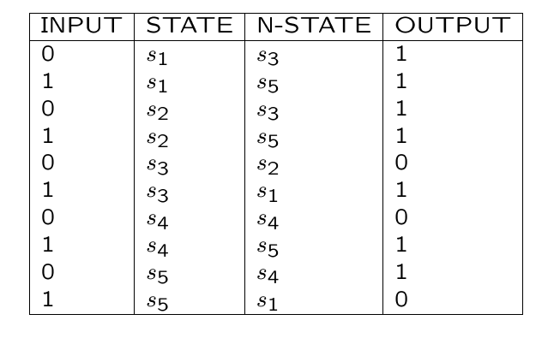
Example
Notes:
The state transition table is a tabulation of the state transition and output functions. Its corresponding graph-based representation is the state transition diagram.

Slide 8
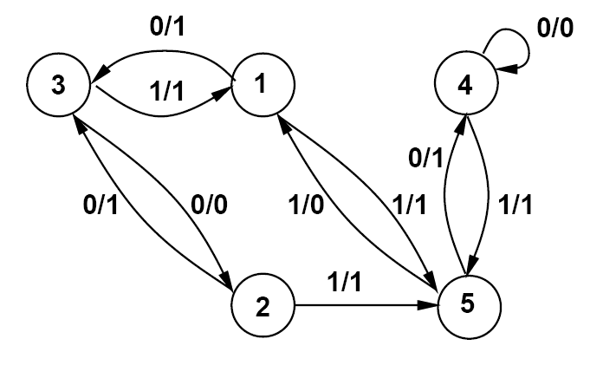
Example
Notes:
Nodes are states. Arcs are transitions. Labels on arcs are of type I/O

Slide 9
Example
a’b’ + r/0
s0
r/0
r/0
ab’r’/0
a’br’/0
b’r’/0
a’r’/0
s1
s2
abr’/1
r/0
br’/1
ar’/1
s3
r’/1
Notes:
This is an example of a synchronizer, that issues a signal as soon as signals a and b are received.

Slide 10
FSM-based models
Synchronous languages:
Esterel, Argos, Lustre, SDL
Graphical formalisms:
FSMs, hierarchical FSMs, concurrent FSMs
StateCharts
Program-state machines
SpecCharts
Notes:
There are different embodiments of the FSM model.
There are languages, like the procedural language Esterel and the declarative language Lustre.
There are also graphical formalisms, such FSMs and their extensions, most notably State Charts and derivatives.

Slide 11
State Charts
Proposed by Harel
Graphic formalism to specify FSMs with:
Hierarchy
Concurrency
Communication
Tools for simulation, animation and synthesis
Notes:
State Charts are extensions to the Finite State Machine Model.
The basic idea is to use hierarchy to capture models that would not fit on one screen or on a sheet of paper.
Hierarchy breaks the behavior into sub-behaviors, each represented by a FSM-like model.
Communication primitives, like message passing, are built into State Charts.
There are tools for simulation, animation and synthesis for State Charts.

Slide 12
State Charts
States
Transitions
Hierarchy
OR (sequential) decomposition
State → a sequence of states
AND (concurrent) decomposition
State → a set of concurrent states
Notes:
Each state chart model consist of states and transitions.
The hierarchy has two types:
A sequence of states can be described by a single state at a higher hierarchy level.
A state may represent concurrent behaviors at a lower hierarchy level.

Slide 13
State charts
Top_level_uart
transmitter
receiver
tx_mode
rx_mode
csr(2)=1
csr(3)=1
idle
transmit
idle
receive
csr(2)=0
csr(3)=0
load_thr / load:=1;
[read_enable=1] /
tx_hold_reg;=data_in;
filoful:=1
empty
loaded
empty
loaded
rd(tx_hold_reg)/load:=0
read_fifo_cmd/filoful:=0
uart_mode
[csr(2..3)=’11’]
normal_tx_rx
echo_active
[csr(2..3)=’11’]
Notes:
This state chat example of a UART shows three parallel sub-behaviors.
In turn, the transmitter and receiver models split up in two concurrent behaviors each.
Each internal model is like a FSM with entry and exit points.

Slide 14
State Charts Additional features
State transitions across multiple levels
Timeouts:
Notation on transition arcs denoting the max/min time in a given state
Communication:
Broadcast mechanism based on event generation and reception
History feature:
Keep track of visited states
Notes:
State Charts supports transitions across the hierarchy, timeouts and simple message passing.

Slide 15
StateCharts
Advantages:
Formal basis
Easy to learn
Support of hierarchy, concurrency and exceptions
Avoid exponential blow up of states
Disadvantages:
No description of data-flow computation
Notes:
The advantages of State Charts are its formal basis derived from FSMs, as well as the fact that they are intuitive and easy to learn. The hierarchy contains the possibly exponential blow-up of states in concurrent behaviors.
The major disadvantage of State Charts is the lack of data-flow modeling ability,

Slide 16
Program State Machines
Combining FSM formalism with program execution
In each state a specific program is active
Hierarchy:
Sequential states
Concurrent states
In a hierarchical state, several programs may be active
Notes:
Program State Machines are a general model to include data flow descriptions.
PSMs can be built on top of either FSMs or State Charts. The idea is that each state can contain a program that is executed while the system is in that state.

Slide 17
SpecCharts
Based on Program State Machines
Introduced by Gajski et al.
Extension of VHDL:
Compilable into VHDL for simulation and synthesis
Behavioral hierarchy
Combining FSM and VHDL formalisms
Leaves of the hierarchy are VHDL models
Notes:
SpecCharts is a specific example of PSMs. It can be seen as an extension of the VHDL language which is embedded within a FSM framework: thus it support a behavioral hierarchy.

Slide 18
Example
E
port P,Q: in integer;
B
type int_array is array(natural range<>) of integer;
signal A: int_array( 15 downto 0 );
X
Y
Z
variable i, max:integer;
x1
z1
max-0;
for i=1 to 20 do
if (A[i] > max) then
max = A[i];
end if;
end for
e1
e4
x2
z2
e2
e5
e3
TOC: e2, e3
TI: e1
Notes:
This examples shows different transition arcs. Graphically, ToCs have a square in the tail, while TI do not have it.

Slide 19
State transitions
Sequencing between sub-behaviors are controlled by transition arcs
TOC - Transition on completion
Program terminates AND transition condition is true
TI - Transition immediate
Transition condition is true
A transition arc is labeled by a triple:
(transition type, triggering event, next behavior)
Notes:
Within SpecCharts, sequencing transitions are controlled by transition arc, each arc labeled by a triple. This triple spells the transition type (ToC or TI), the triggering event and the following behavior

Slide 20
SpecCharts semantics
Timing semantics similar to VHDL
Synchronization:
Use wait statement
Use TOC looping back to the top of the program
Communication:
Using variables and signals
Message passing (send/receive)
Simulation;
Model can be flattened to VHDL
Notes:
The timing semantics of SpecCharts is similar to VHDL, and synchrnization is done using the wait statement. Process models that repat indefinitely can be represented by ToCs that loop back to the process start point.
Communication is SpecCharts is done (as in VHDL) using variables and signals, and with a message passing paradigm.

Slide 21
Module 2
Objectives:
Expression-based formalisms
Control-flow expressions

Slide 22
Expression-based formalisms
Represent sequential behavior by expressions
Advantages:
Symbolic manipulation
Translation into FSM models
Disadvantages:
Loss of data-flow information
Notes:
Expression-based formalisms represent sequential behavior by expressions.
The advantage is to have a synthetic representation of control flow, which can be used for control-flow analysis and optimization. Expression-based formalisms can be mapped into FSMs, since the expressive power is the same. The disadvantage of these approaches is the loss of data flow information.

Slide 23
Regular expressions
Model sequential/concurrent behavior
Expressive power equivalent to FSMs
Known techniques for synthesis and analysis
Disadvantages:
No explicit way to express branching
No distinction between concurrent and alternative behavior
Notes:
Regular Expressions can be used to model the control flow.
Their limits are related to the fact that there are only two operators (.,+) that can be used to represent serial and sequential composition.
There is no specific operator for representing alternative flows (due to branching).

Slide 24
Control-flow expression formalism
Expressions capturing a high-level view of control-flow while abstracting data-flow information
Expressions are extracted directly from HDL or programming language specifications
Cycle-based semantics provides a formal interpretation of HDLs
Based on the algebra of synchronous processes (Process Algebra)
Notes:
Control-flow expressions (CFEs) are an extension of regular expressions that can be related directly to HDLs and thus can capture essential features of hardware models. Control-flow expressions have a synchronous cycle-based semantics. All operations take 0,1 or an integer number of cycles to execute.
In particular, symbol 0 is used to represent a single-cycle No-operation.

Slide 25
Control-Flow Expressions
Composition
HDL
CFE
Sequential
begin P; Q end
p · q
Parallel
fork P; Q join
p װ q
if (c)
P ;
Alternative
else
c : p + c : q
Q ;
while (c)
(c: p)*
Loop
P ;
wait (!c)
(c: 0)* .p
P ;
always
Infinite
p^{ω}
P ;
Notes:
This is the syntax of CFEs:
Sequence is represented by .
Parallelism by symbol ||
Guarded execution is represented as c:p
Alternative flows are represented as the composition (with symbol +) of guarded execution
Iteration is represented by the * superscript, as in regular expression. A guard controls the iteration exit.
Wait is represented by an iteration of no-operations.
Process are represented by the superscript omega, as in the case of omega-regular automata.

Slide 26
Example of design problem Ethernet controller
Receive Unit
DMA-RCVD
RXE
Host CPU
DMA-FRAME
DMA-BUFFER
DMA-BIT
RXD
TXD
DMA-XMIT
XMIT-FRAME
XMIT-BIT
TXE
Memory
Transmit Unit
CRS
ENQUEUE
EXEC-UNIT
CDT
Execute Unit
Network Coprocessor
System Bus
Problem
Avoid bus conflicts
Notes:
We introduce the CFEs with an example. Here we have a system consisting of 3 independent processes with their own HDL description.
We focus on the design of a correct bus interface, that avoids simultaneous writes on the bus.

Slide 27
Example of design problem Ethernet controller
MEMORY
P1
P2
P3
always
begin
write bus
receive data
end
always
begin
initialize
wait ( tr ready )
read bus
end
always
begin
wait ( free bus )
read bus
end
p = p1 װ p2 װ p3
p1 = [a.0]^{ω}
p2 = [0.(c:0)*.a]^{ω}
p3 = [(x:0)*.a]^{ω}
Notes:
The model is abstracted in the top part of the picture with a few lines of essential pseudo-code
For the 3 processes. The CFE model says that
There are 3 processes running in parallel
Process 1 is the repetition of a bus access (a) followed by an operation taking one cycle (0)
Process 2 is the repetition of an operation taking one cycle (0) followed by the conditional execution (on clause c) of a bus access (a)
Process 3 is an access to the bus (a) followed by an unspecified wait (x)
The issue is to quantify the wait (x) to access the bus in process 3 for correct operation.

Slide 28
Model properties
Fully deterministic model.
Non-determinism captured by decision variables affecting the clauses
Design space modeled by decision variables
An implementation is an assignment to decision variables over time
Constraints expressible by CFEs
Timing, synchronization, resource usage
AWAYS and NEVER sets
Set of actions that always/never execute simultaneously
Notes:
CFE models are fully deterministic. Non-determinism can be captured by decision variables affecting the clauses.
Thus, the space of all possible implementations is spanned by the possible assignment to these decision variables.
As a result, design and optimization consists in restricting the possible behavior by assigning values (in time) to the decision variables, and thus removing the non-determinism.
Finally, several types of constraints can be applied to CFES.
In particular, ALWAYS and NEVER sets represent operations that must (or must not) execute concurrently.

Slide 29
Example Control-Flow Expressions
MEMORY
P1
P2
P3
always
begin
write bus
receive data
end
always
begin
initialize
wait ( tr ready )
read bus
end
always
begin
wait ( free bus )
read bus
end
p = p1 װ p2 װ p3
p1 = [a.0]^{ω}
p2 = [0.(c:0)*.a]^{ω}
p3 = [(x:0)*.a]^{ω}
Decision variable x :
Quantifies the synchronization for p3
x₀ = 1 – Wait because p1 is accessing the bus
x₁ = c – Use bus unless p2 does it
Notes:
This example shows a realization of the model by assigning a value to variable x.

Slide 30
Example Control-Flow Expressions
MEMORY
P1
P2
P3
always
begin
write bus
receive data
end
always
begin
initialize
wait ( tr ready )
read bus
end
always
begin
wait ( free bus )
read bus
end
p = p1 װ p2 װ p3
p1 = [a.0]^{ω}
p2 = [0.(c:0)*.a]^{ω}
p3 = [(x:0)*.a]^{ω}
NEVER = {a,a}
Never access the bus twice simultaneously
Notes:
This example shows the NEVER constraint: it should never happen that two bus accesses happen concurrently.

Slide 31
Example Synchronization
SENDER
RECEIVER
r
k
a
a
Synchronization between a sender and a receiver in a blocking protocol
Sender = (x : r)*.a
Receiver = (y : k)*.a
ALWAYS = {{a; a}}
NEVER = {{r; k}}
Notes:
This example shows the synchronization between a ender and a receiver.
Both processes have wait loops controlled by x and y respectively.
When a data is sent, it should be received in the same cycle.
This is the meaning of the ALWAYS statement.
At the same time, the system should never be waiting on both ends, i.e., operations r and k should never be concurrent.

Slide 32
Design with CFEs
Representation:
A CFE can be compiled into a specification automaton
Representing all feasible behaviors
Synthesis:
A control-unit implementation is a FSM
Derivable from a specification automaton by assigning values to decision variables over time
Optimization:
Minimize a cost function defined over the decision variables
Notes:
We briefly sketch the design with CFEs.
Each CFE model can be compiled into a specification automaton, representing all feasible behaviors.
Synthesis consist of restricting this automaton by assigning values to the decision variables.
The restricted automaton is a FSM implementing a correct control function.
There are many ways of doing the restriction: given a design objective (e.g., minimum latency), an optimization algorithm can yield the appropriate optimal control.

Slide 33
CFE Summary
Control-flow expression are a modeling tool
Formal semantic:
Support for synthesis and verification
Synthesis path from CFEs to control-unit
Notes:
In summary, CFEs are a modeling tool for complex systems that involve concurrent processes.
This abstraction has a formal semantics and can be very useful for both synthesis and verification.

